Slide 1
Analysis of Fire Fighting Methods using Cellular Automaton Modeling
Matthew Wilson, Brent D. Foy
Notes:
Put on physics department and psychology department

Slide 2
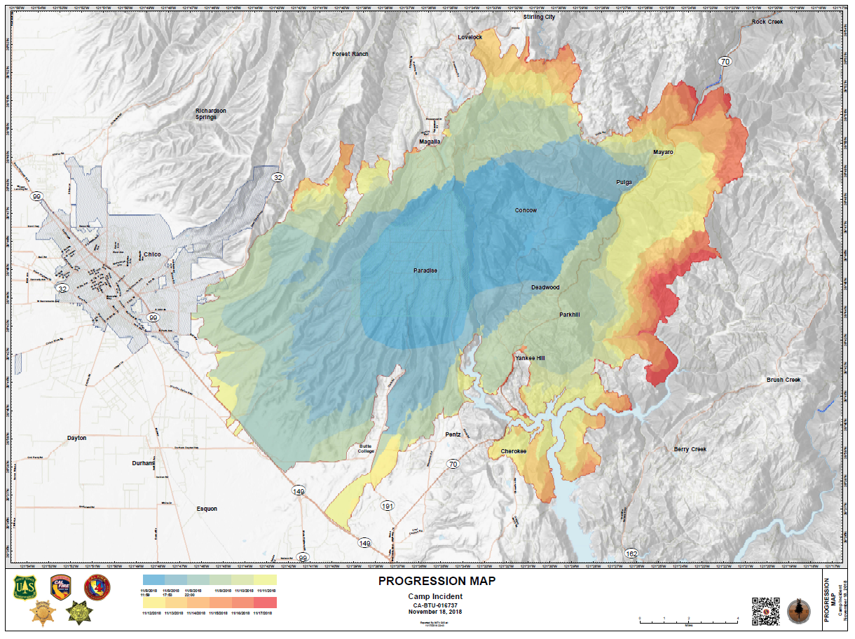
Forest Fires and their Effects
Camp Fire Wildfire
Destroyed over 150,000 acers
85 civilian deaths (2018) [1]

Slide 3
Cellular Automaton
Made up of a grid of cells
Simulates interactions between closest cells
Most known example is Conway’s Game of Life

Slide 4
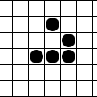
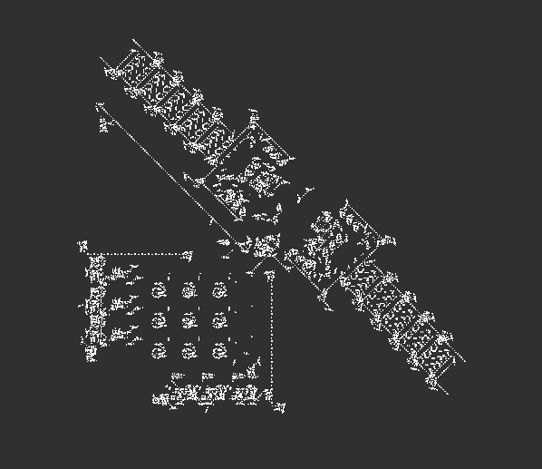
Conway's Game of Life
Three Rules
A live cell survives if it has two or three live neighbors
A new cell is born whenever there are three live neighbors
All other cells either die or remain inactive
“Glider”
Turing machine
[3]

Slide 5

2D Convolution
Takes a matrix
Slides kernel over matrix
Kernel is usually a smaller matrix
Zero padded for same size
[2]

Slide 6
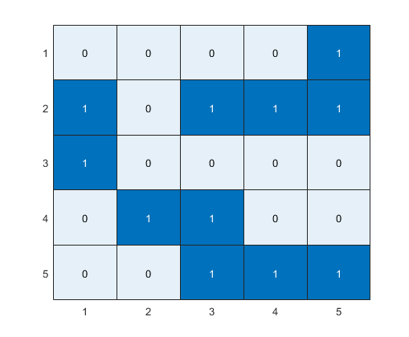
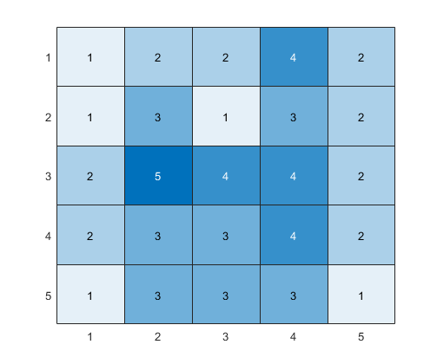
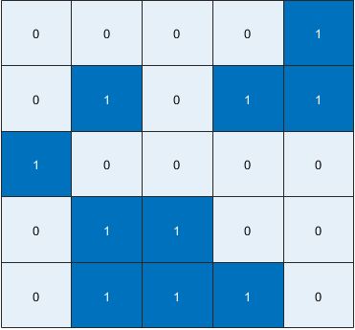
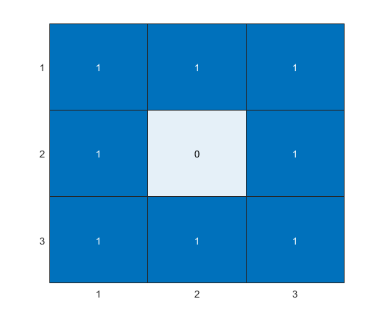
Game of Life Convolution
Kernel
2D Convolution
Initial Game of Life Board
New Board

Slide 7
Methods Tested
No protection – Control
Cutting down trees
Starting controlled fire
Over Quenching – Put out majority of fires

Slide 8
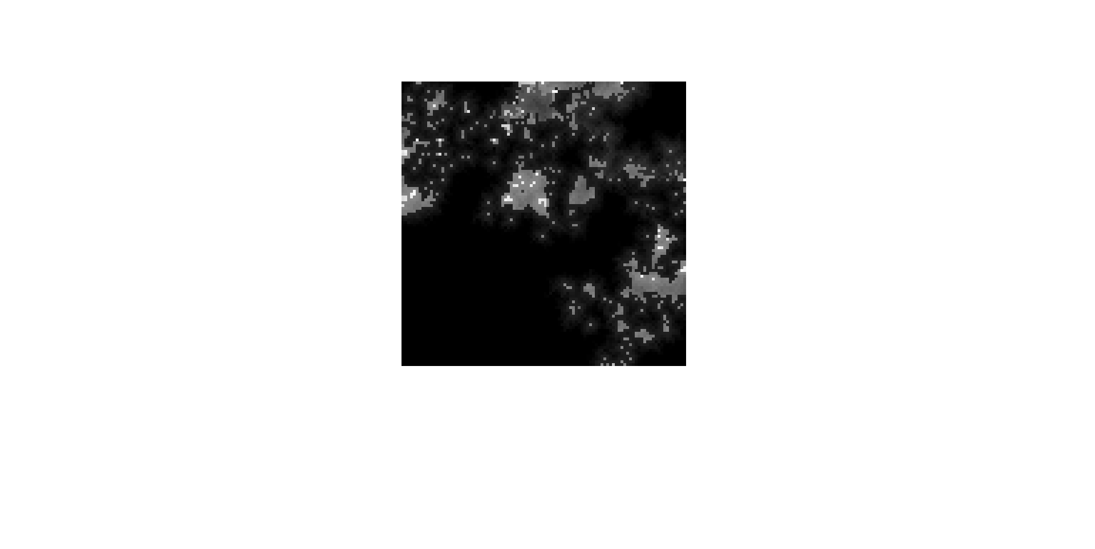
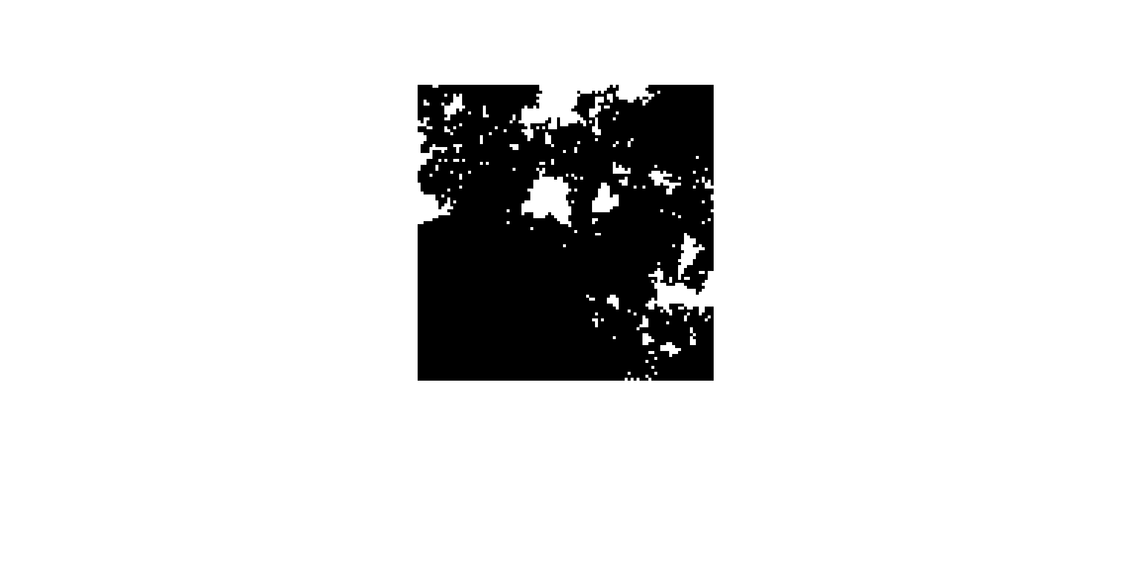
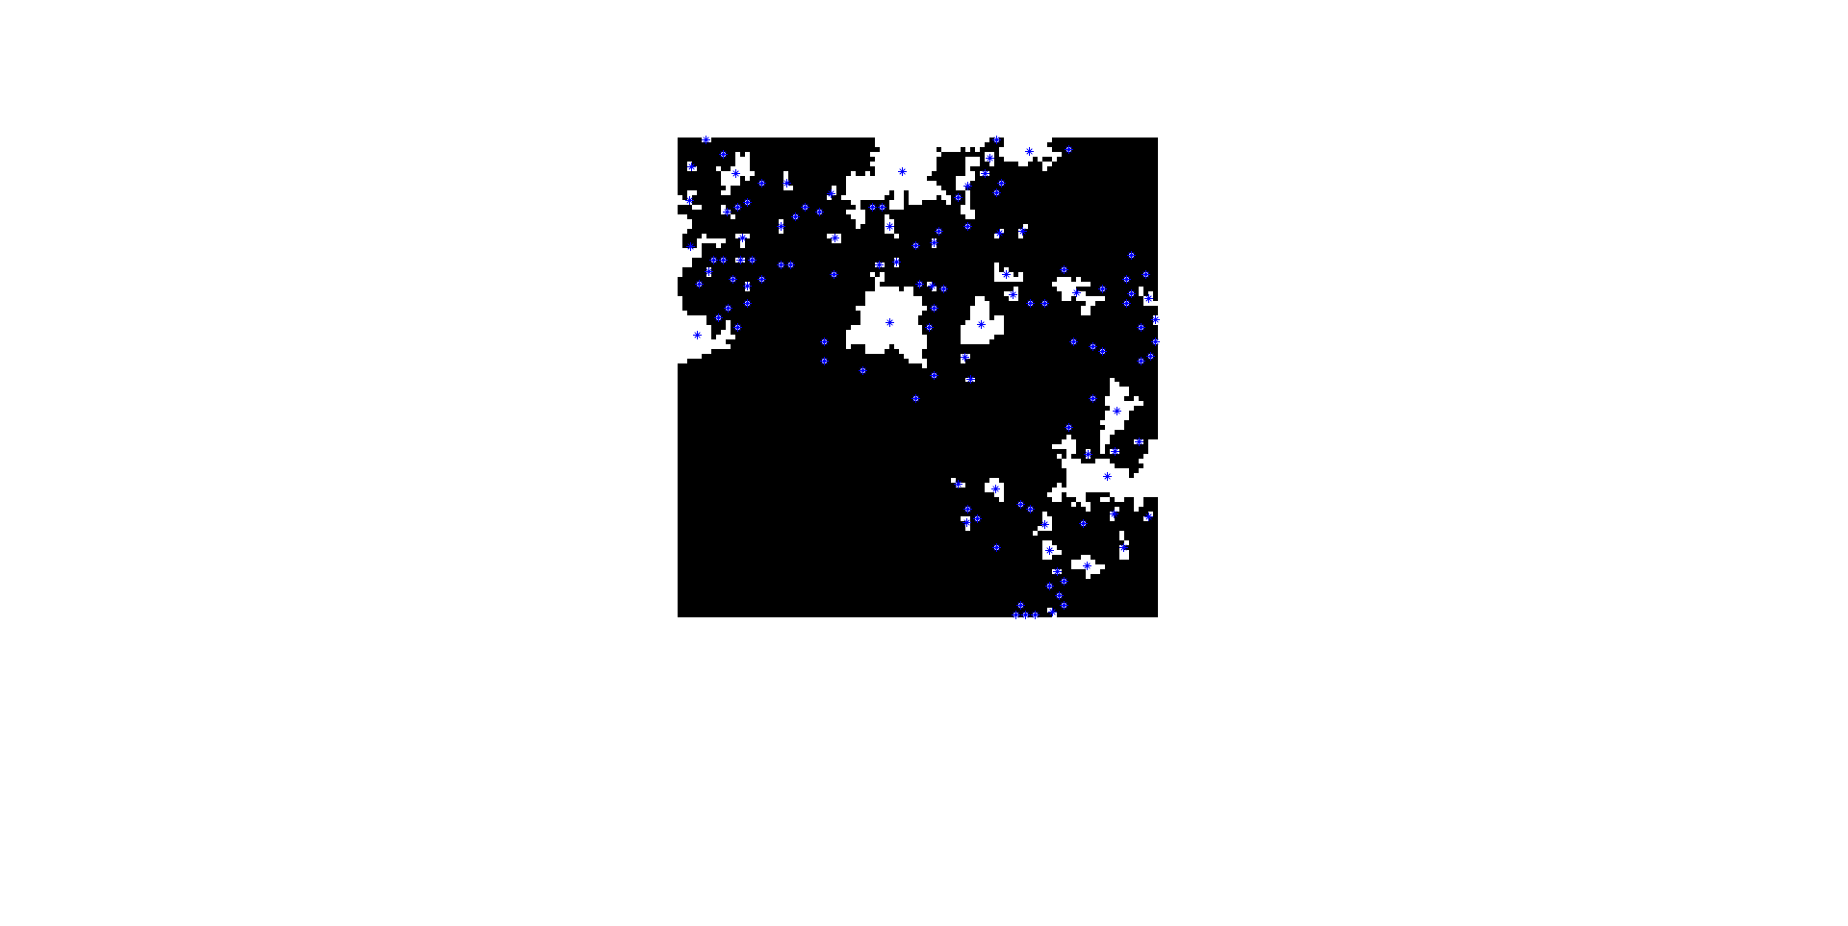
Cutting Trees and Controlled Fire
Threshold at 20%
Weighted Centroid
Original

Slide 9
Tree Simulation
Plant age increased by simulation step size
Plant mass increases at linear rate until age of 100 years
Plant mass rapidly decrease until dead at 120 years
Plants spread with a 2D convolution with a 3x3 Kernel of 0.01
Matrix of random values between 0-1 generated
New tree created if random value is bellow convoluted value

Slide 10
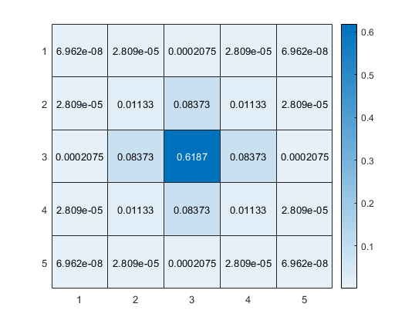
Fire Simulation
Mass matrix element by element multiplied by binary mask of trees on fire
Matrix 2D convolution with 5x5 Gaussian Kernel
Matrix of random values between 0-1 generated
New tree set on fire if random value is bellow convoluted value
5x5 Gaussian Kernel

Slide 11

Simulation
Lighter colors is more mass
Over 60 GB data created
2 minutes each to process control and over quenching
20 minutes to process cutting trees and controlled fire

Slide 12
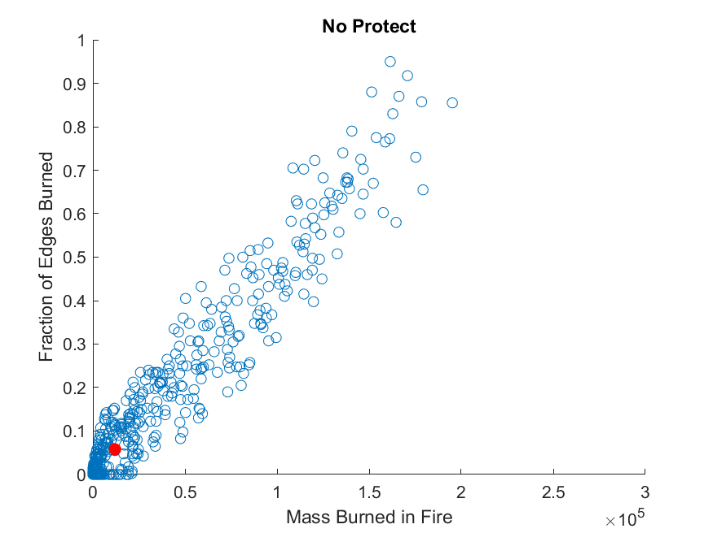
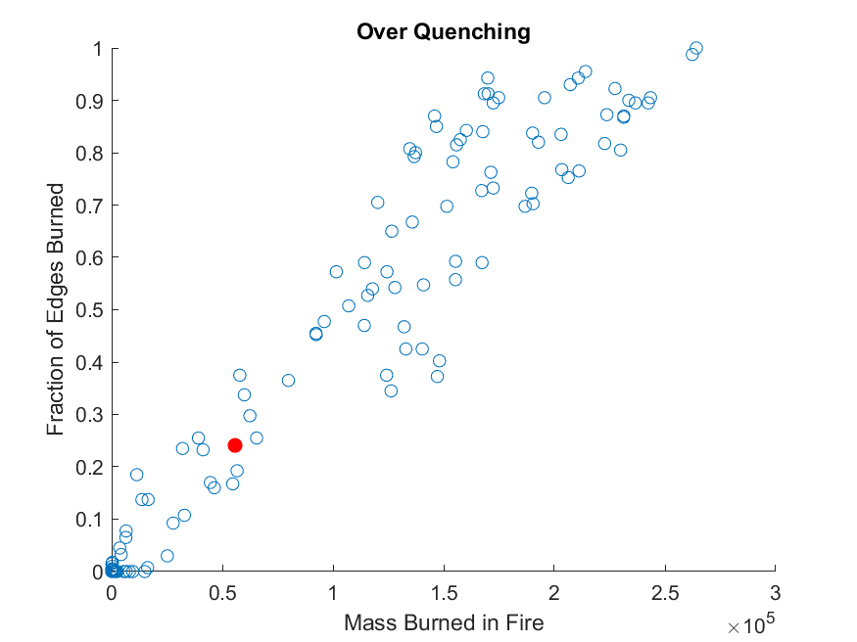
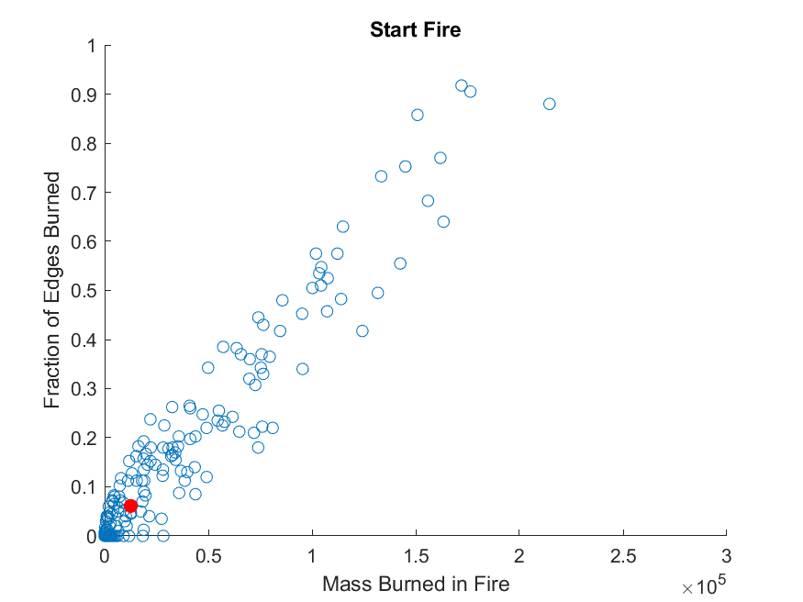
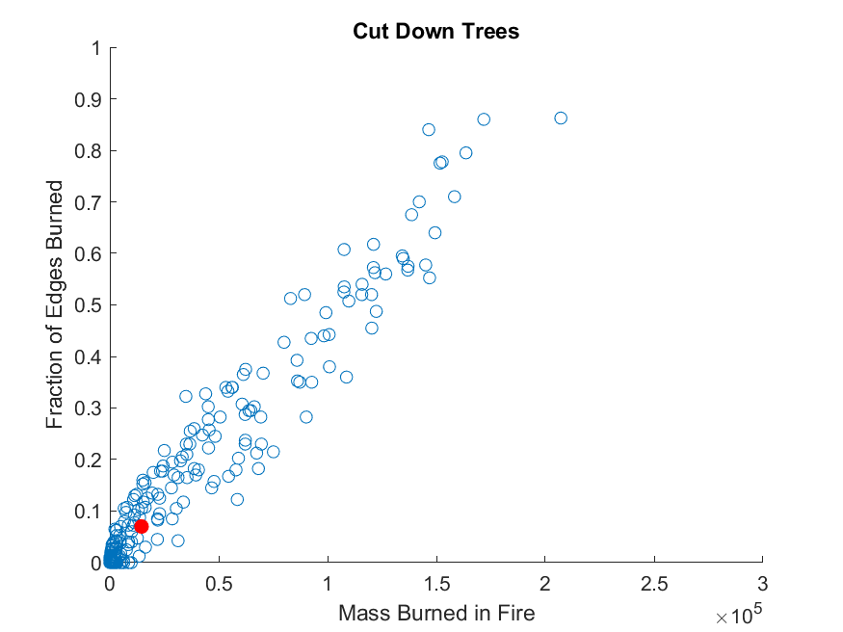
Graphs

Slide 13
References
[1] Camp Fire Final report (2018)
[2] https://towardsdatascience.com/types-of-convolutions-in-deep-learning-717013397f4d
[3] A. Adamatzky, Game of Life cellular automata. [electronic
resource]. (Springer, 2010).

